Slide 1

Faculty of Computing and Information Technology
AWS Cloud Challenge: Deploying a Scalable and Secure Booking & Ticketing Platform
DFT2 (GROUP 12)
Assignment
AMIT3253 Cloud Computing for Business (202605)
Tutor: YAP XIANG LOO WINNIE
Date of Submission: 7/9/2026
Name (Block Capital) | Student ID
CHENG JUN YU | 25WMD07989
KHOO SEE ZE | 25WMD08818
LOW KAR WAI | 25WMD07972

Slide 2
TUNKU ABDUL RAHMAN UNIVERSITY OF MANAGEMENT AND TECHNOLOGY
Group Contract Form
Faculty: Faculty Of Computer Science
Programme: Diploma in Information Technology
Year of Study: Y2
Semester: S1
Course Title: CLOUD COMPUTING FOR BUSINESS
Course Code: AMIT3253
Group Assignment/ Project Title: Swimming pool booking system
Name of Tutor: YAP XIANG LOO WINNIE
Tutorial Group: G12
Student Name and ID | Role(s)/Task(s) Assigned | Signature and Date
Cheng Jun Yu 2507989 | AWS Service: VPC、Subnets(public/private)、Internet Gateway、Route Tables、Security Groups、NAT Gateway、RDS, EC2 、AMI、Launch Template、Auto Scaling Group、Target Group、Application Load Balancer, S3, SSM Parameter Store Report part: Secure, High Performing | 7/9/2026
Khoo See Ze 2508818 | AWS Service: SNS + Lambda Report part: Functional, AWS Architecture Design, Load Balanced | 7/9/2026
Low Kar Wai 2507972 | AWS Service: CloudWatch (Alarm+Dashboard) , WAF Report part: Solution Overview Diagram, Cost Optimized, Scalability | 7/9/2026

Slide 3



Member Profiles
Name (Block Capital) | Contact number | Profile Photo
CHENG JUN YU | +6011-2800 3667
KHOO SEE ZE | +6011-56507798
LOW KAR WAI | +6014-9815779

Slide 4
Assignment Rubrics
Part 1: Reporting and Documentation (70 marks)
Criteria | Unsatisfactory (1-3) | Needs Improvement (4-5) | Good (6-8) | Excellent (9-10) | Mark
AWS Architecture Diagram (5m) & Solution Overview Diagram (5m) | Diagram is missing, heavily incomplete, or uses non-standard cloud icons. Network boundaries (VPC, subnets) are omitted or incorrect. Flow diagram is missing, or the sequential flow of data from the end-user to the backend database is entirely absent or illogical. | A diagram is provided but lacks detail. Component relationships are vague, or structural layout (public vs. private subnets) is poorly defined. A diagram is provided, but the transactional flow is confusing, or the user journey lacks clear step-by-step logic. | The diagram is complete and mostly accurate. Clearly displays the custom VPC layout, subnets, EC2 instances, ELB, ASG, and RDS with minor labeling gaps. The diagram successfully maps out the functional user journey and data pathway from the web interface down to the data tier with minor logical gaps. | Exceptional, production-ready infrastructure diagram. Perfectly details the entire AWS environment, security group boundaries, and gateways. A highly detailed visual mapping of the functional data journey. Flawlessly illustrates how requests progress through the load balancer, application, and database transactions.
Functional | The booking platform is non-functional. Users cannot view slots/events or make reservations, and database operations fail completely. | The website loads, but core booking components are broken. Database connections are unstable, or errors occur during data submission. | The booking platform is functional. Users can browse events and book tickets successfully, though minor UI/UX bugs or validation errors exist. | The application is fully operational and seamless. Users can flawlessly browse events, select quantities, complete bookings, and verify data updates in the database.

Slide 5
Assignment Rubrics (cont.)
Part 1: Reporting and Documentation (70 marks)
Criteria | Unsatisfactory (1-3) | Needs Improvement (4-5) | Good (6-8) | Excellent (9-10) | Mark
Secure | Security is ignored. The database is exposed to the public internet, or Security Groups are wide open (0.0.0.0/0) across all ports. | A VPC is present, but resources are misplaced (e.g., database sits in a public subnet). Security groups are overly permissive. | Network segregation is mostly correct. The database sits in a private subnet, and Security Groups restrict basic traffic with minor rule optimization gaps. | Exemplary security implementation. Custom VPC has isolated public and private subnets. Both the EC2 application instances and the RDS database are strictly isolated within private subnets. Public access is restricted entirely to the Application Load Balancer, which demonstrates proper request handling by securely routing internet traffic to the private application tier. Security Groups act as tight, least-privilege firewalls.
Cost Optimized | Cost report is missing or completely inaccurate. Overpriced or unnecessary enterprise-grade AWS resources are chosen without consideration of the lab budget. | Cost estimation is provided but lacks detail or calculation structure. Resource choices are poorly justified or slightly push the budget limits. | A complete AWS Pricing Calculator report is included with approximate estimations. Resource choices (EC2/RDS sizing) are reasonably justified for a POC. | Provides a highly comprehensive, exported AWS Pricing Calculator report. Resource sizing is expertly optimized for a budget-conscious POC with strong written justifications.

Slide 6
Assignment Rubrics (cont.)
Part 1: Reporting and Documentation (70 marks)
Criteria | Unsatisfactory (1-3) | Needs Improvement (4-5) | Good (6-8) | Excellent (9-10) | Mark
High Performing | No stress or load testing was conducted. The application crashes immediately or becomes completely unresponsive under minimal traffic. | Load testing was attempted, but results are missing analysis or screenshots. The application experiences severe latency or errors under mild simulation. | Stress testing was successfully executed using a simulation tool. The system remains stable with acceptable response times, backed by performance screenshots. | Outstanding performance validation. Comprehensive stress testing data and clear metric screenshots prove the platform remains fast, stable, and resilient under a heavy simulated user surge.
Scalability | Automatic scaling wasn't implemented at the application layer, leaving the system vulnerable to crashes under high load. | Automatic scaling was implemented at the application layer. However, scaling was significantly delayed or failed to trigger during peak traffic periods. | Automatic scaling was implemented at the application layer, but the configuration could be improved by adjusting the scaling policies, tracking metrics, or minimum/maximum capacities. | The automatic scaling configuration was optimal, staying strictly within the defined scaling range without hitting the maximum limit frequently. The application layer scaled in and out dynamically and in a timely manner according to live application demand.

Slide 7
Assignment Rubrics (cont.)
Part 1: Reporting and Documentation (70 marks)
Criteria | Unsatisfactory (1-3) | Needs Improvement (4-5) | Good (6-8) | Excellent (9-10) | Mark
Load Balanced | Load balancing wasn't implemented. Traffic hits a single instance directly, creating a single point of failure. | Load balancing was implemented partially. Application traffic was directed to a single Availability Zone instead of utilizing multiple Availability Zones. | Application traffic was distributed across multiple Availability Zones, but configuration gaps caused instances to carry a variable or uneven load. | The application traffic was distributed evenly across multiple Availability Zones and across the instances within those zones. All backend instances were evenly loaded, managing peak user traffic seamlessly without performance degradation.
Subtotal (Part 1)

Slide 8
Assignment Rubrics (cont.)
Part 2: Demonstration Session and Student Effort (30 marks)
Criteria |  | Student Name (Block Capital)
Presentation and Demonstration (15) | Clarity and Understanding (10)
 | Q&A (5)
Student Effort (15) | Suggestion based on Tutorial submission Practical submission Class Participation Advanced Features
Subtotal (Part 2)
TOTAL (PART 1 + PART 2)

Slide 9
Introduction

Slide 10
Introduction
Project: SplashPoint — a cloud-based swimming pool booking system for TAR UMT Campus Aquatic Center
Problem: manual/legacy booking methods cause long queues, scheduling conflicts, and system overload during peak periods
Objective: deploy a scalable, secure, and cost-optimized booking platform as a proof of concept on AWS
Scope: 3 campus pools (1 Olympic-size lane pool, 2 leisure/training pools), public browsing, member accounts, real-time availability, admin management
Notes:
Define the problem or opportunity that you are addressing. Include pictures, figures, and statistics to help the audience better conceptualize the problem or opportunity.
Specify who your users or customers are and what pain points they are experiencing.
For example: “Users complain that the student admissions department website is too slow and isn’t always available.”
Also, list any specific business requirements that you are addressing.
For example: “Improve the experience for users. The web application can be deployed to the AWS Cloud. The application must be highly available, scalable, load balanced, secure, and performant architecture that can support thousands of users.“
Note:
An above-bar overview succinctly defines the problem and opportunity statement. For example: “Customers with media files, such as retail companies, need an easy and cost-effective way to analyze photos and videos of their inventory.”
A below-bar overview is too verbose, technical, or not specific. For example: “The most common media files are .jpg and .mp4. Companies have media files of their inventory.”

Slide 11
AWS Architecture Design

Slide 12
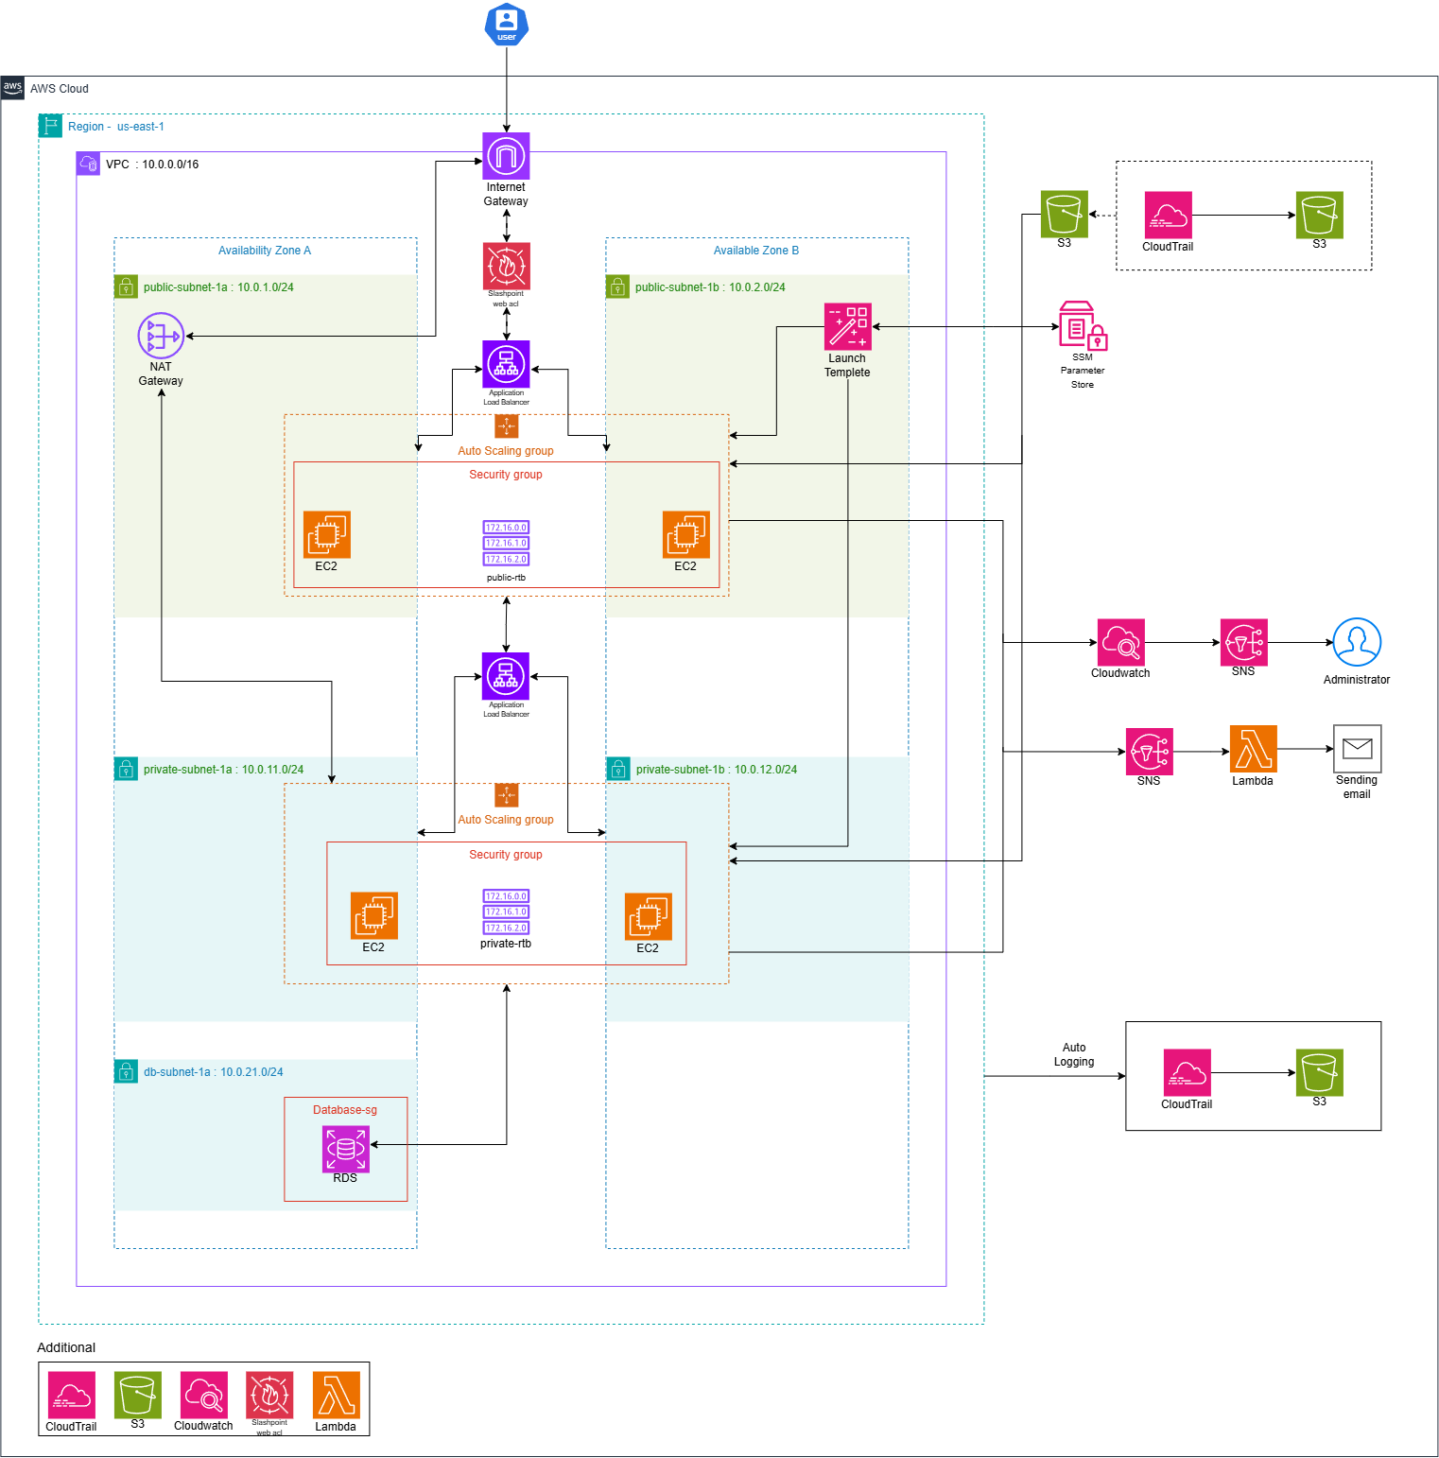
AWS Architecture Design
Notes:
Note: Remove this slide from your final presentation.
This example architecture diagram shows a solution to configure a webhook to link Git with AWS. You can find this example in the Toolkits for PowerPoint at https://aws.amazon.com/architecture/icons.

Slide 13
Solution Overview Diagram
Notes:
Exceeds expectations by incorporating advanced concepts like inheritance, specialization, or generalization.
Utilizes advanced notation or tools to enhance readability and expressiveness.
Represents a model that is not only accurate but also adaptable and extensible for future changes.
Include Assumption/ Business Process

Slide 14
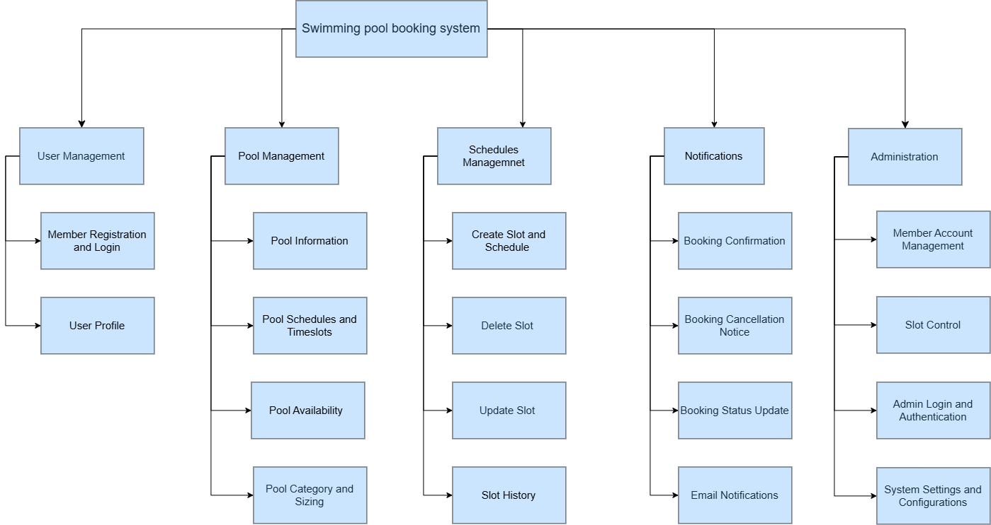
Solution Overview Diagram

Slide 15
Key Features

Slide 16
Functional
Key Features

Slide 17
Key Features - Functional
Web site URL link
http://splashpoint-alb-1364108331.us-east-1.elb.amazonaws.com

Slide 18
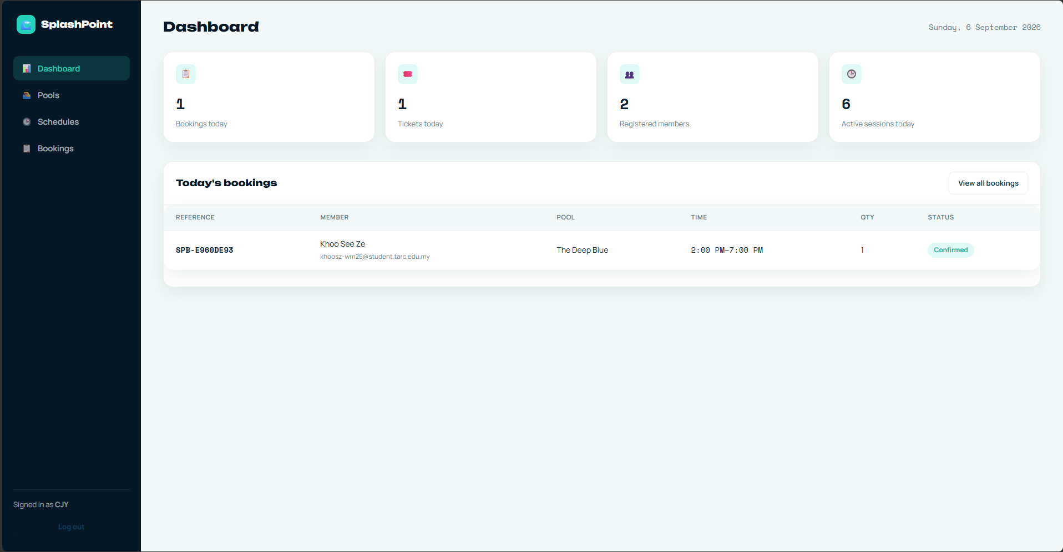
Key Features - Functional
Admin Dashboard

Slide 19
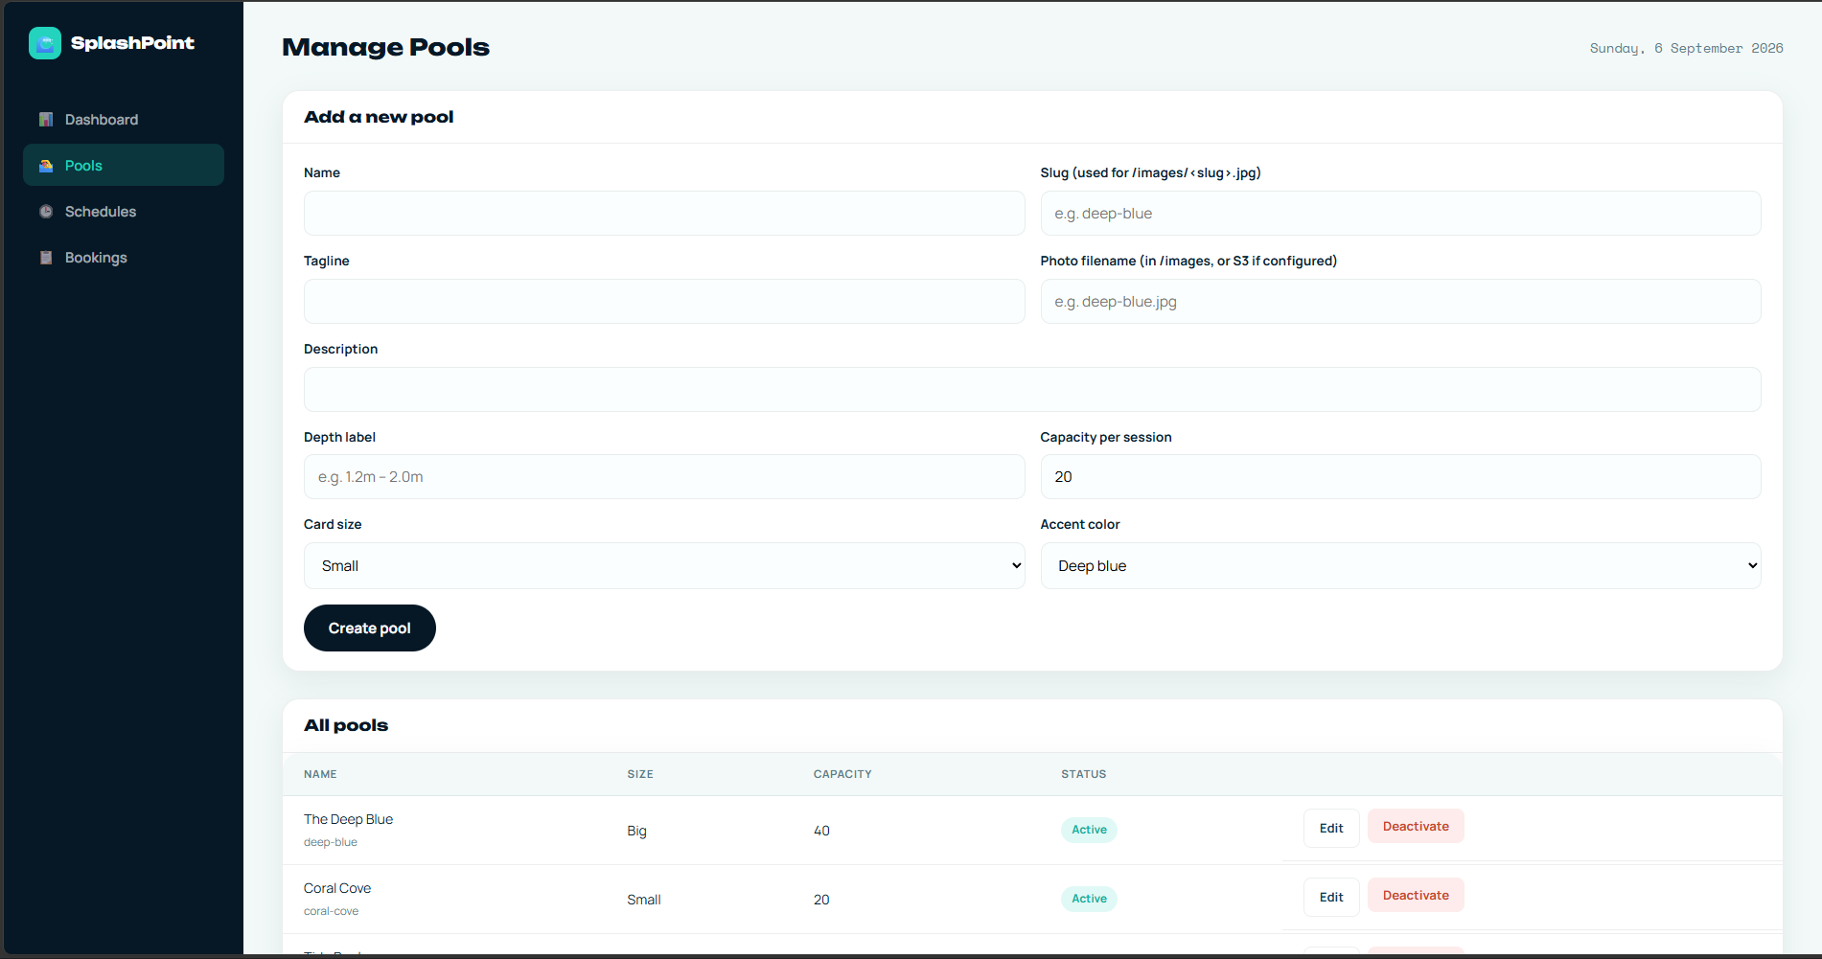
Key Features - Functional
Pools Management

Slide 20
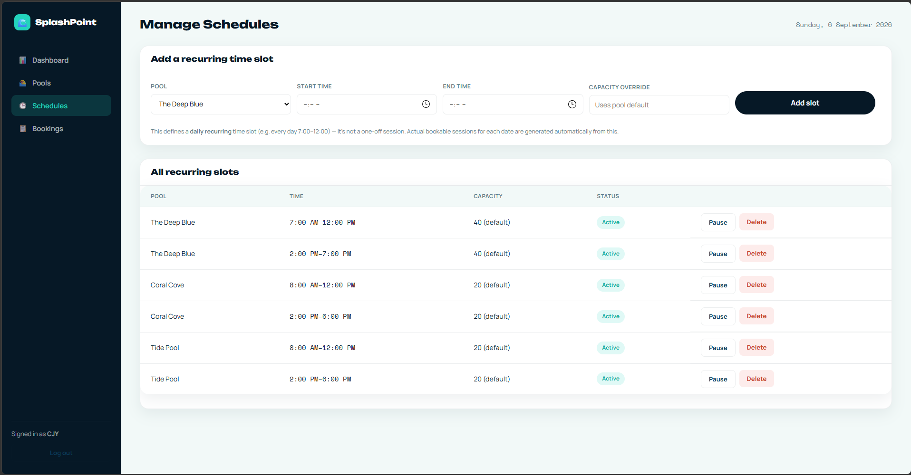
Key Features - Functional
Schedule Management

Slide 21
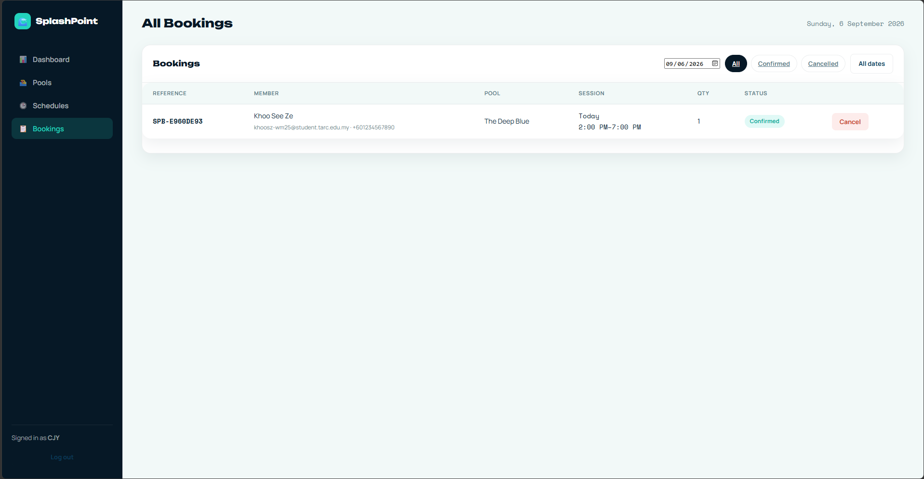
Key Features - Functional
Booking Management

Slide 22
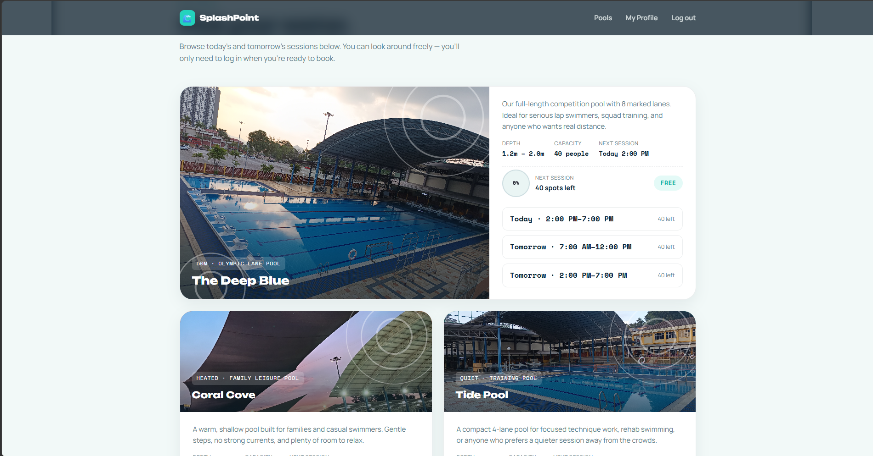
Key Features - Functional
Check Availability

Slide 23
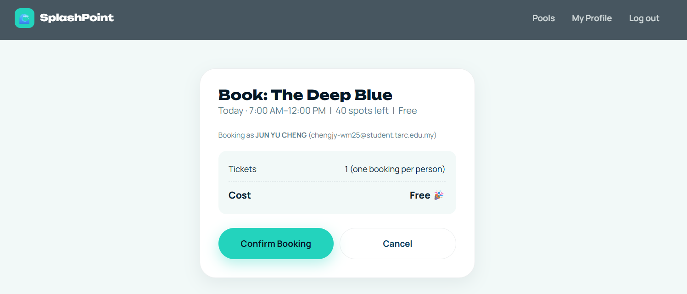
Key Features - Functional
Booking

Slide 24
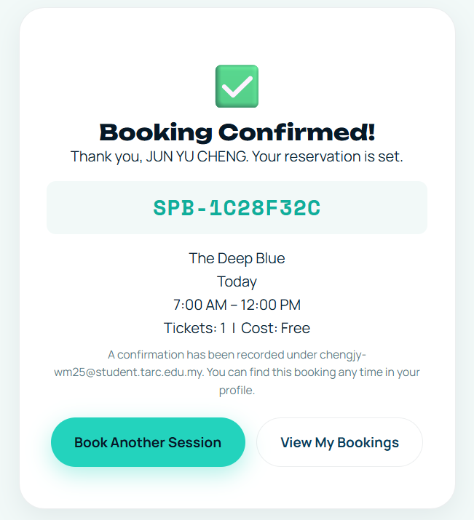
Key Features - Functional
Book Successful

Slide 25
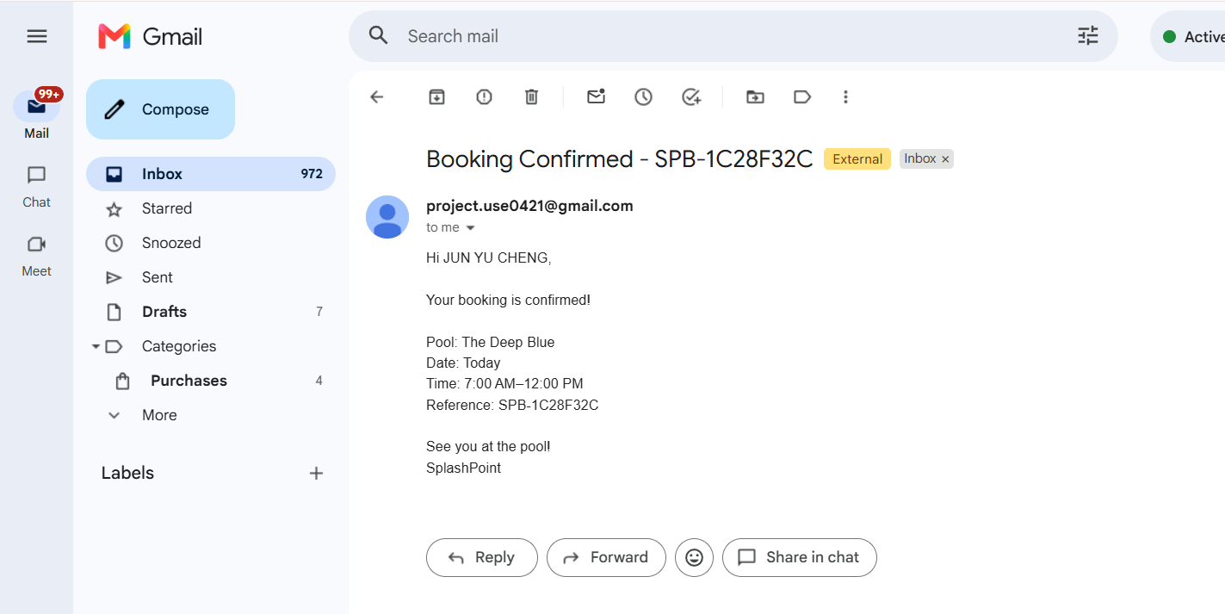
Key Features - Functional
After book successful, will receive a email

Slide 26
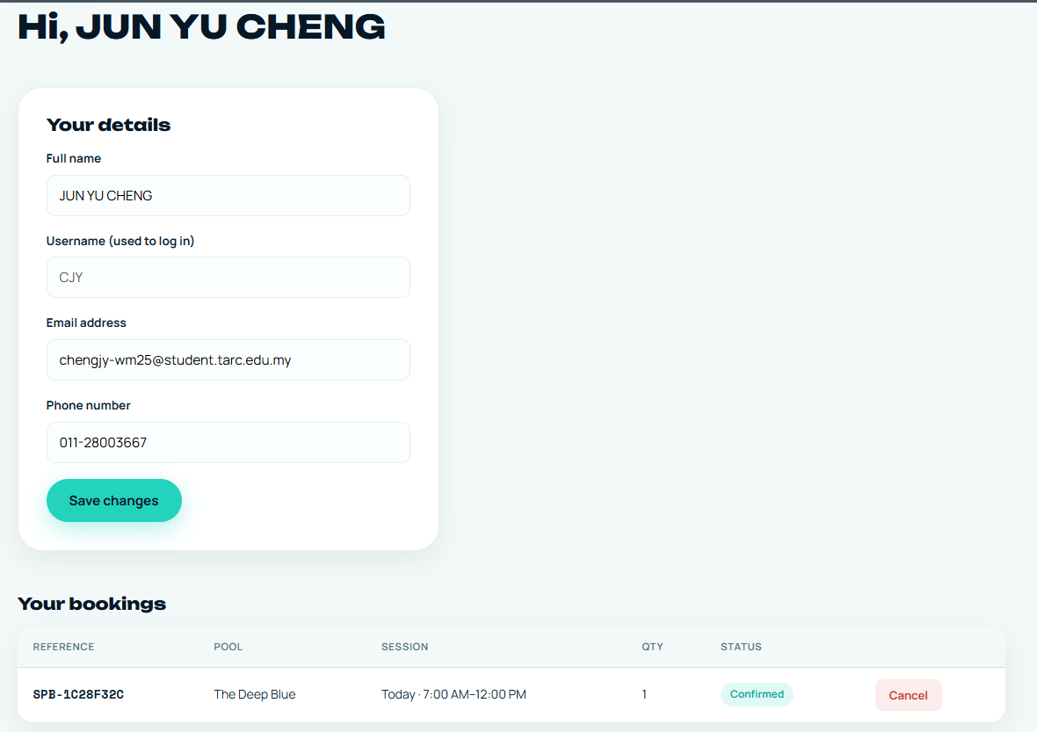
Key Features - Functional
Profile & View / Cancel Booking

Slide 27
Secure
Key Features

Slide 28
Secure
Secure — Network & Data Protection

Slide 29
Secure
Key Features - System Manager Services

Slide 30
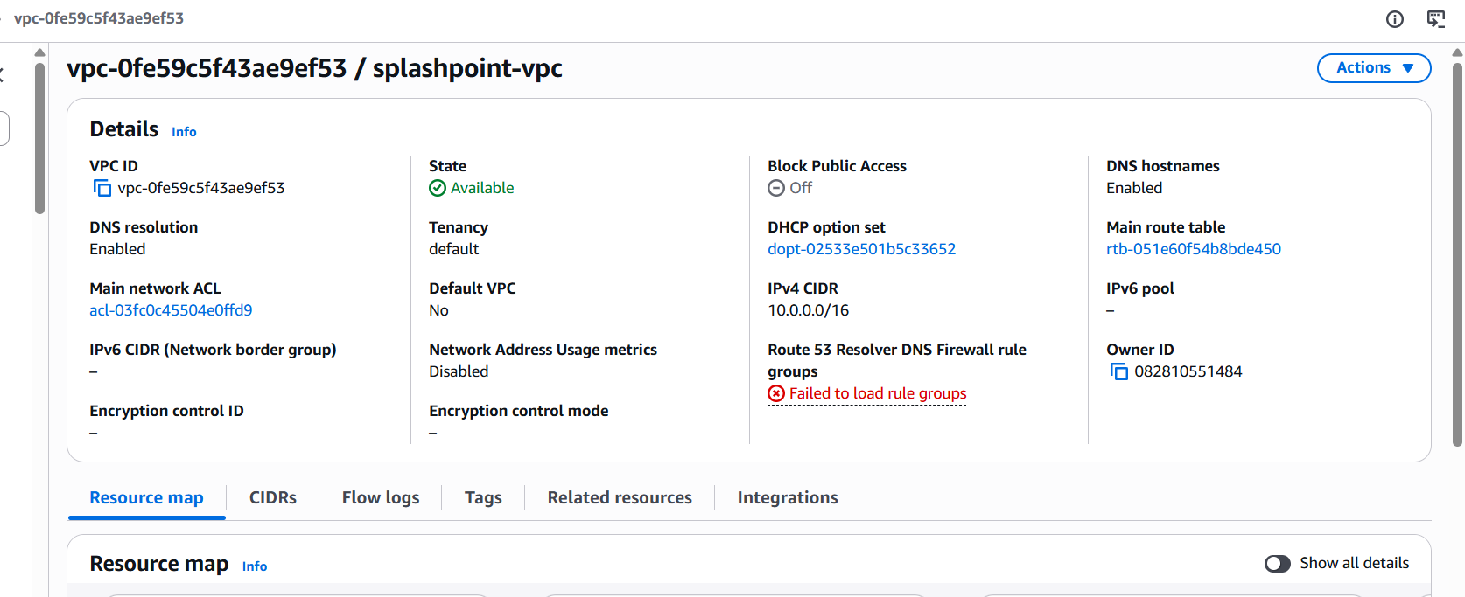
Key Features - Secure
VPC

Slide 31
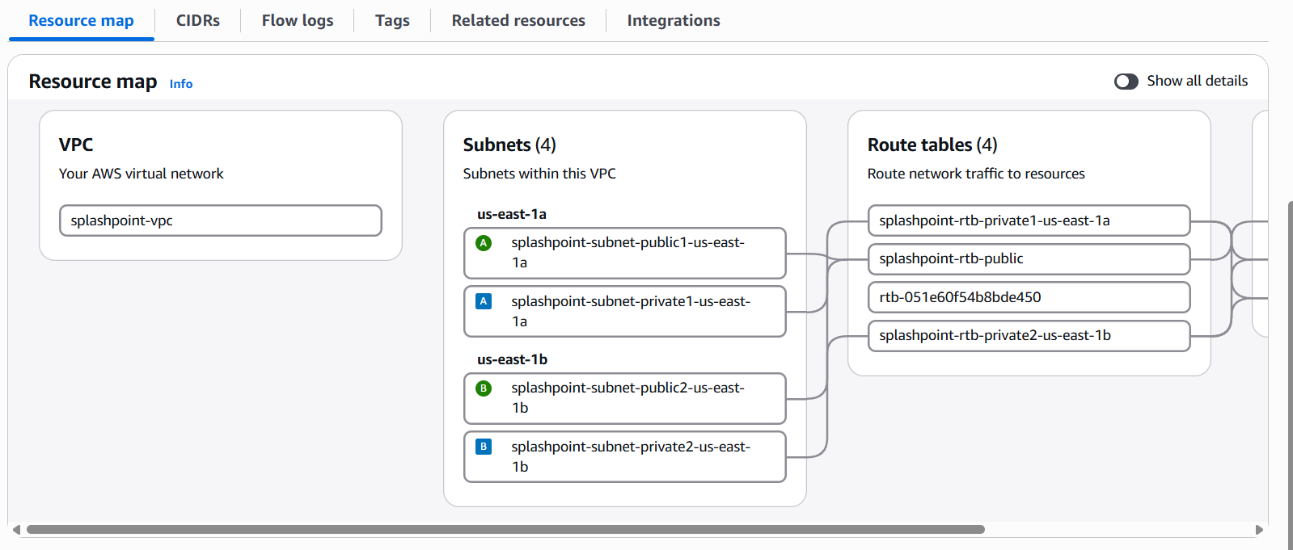
Key Features - Secure
2 AZ - 2 Public & 2 Private Subnet

Slide 32
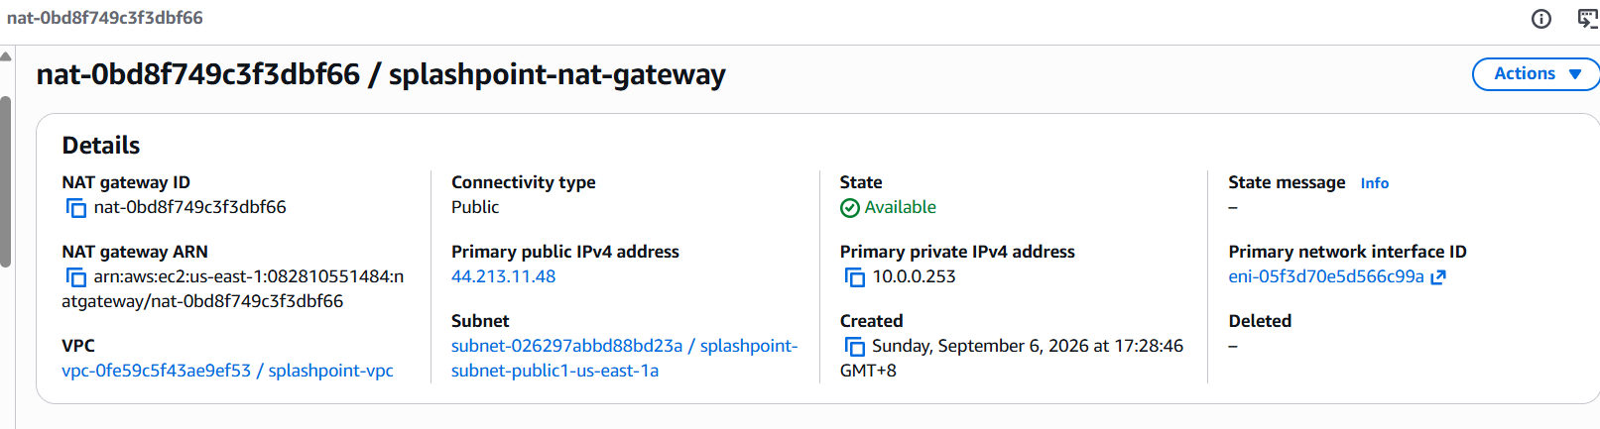
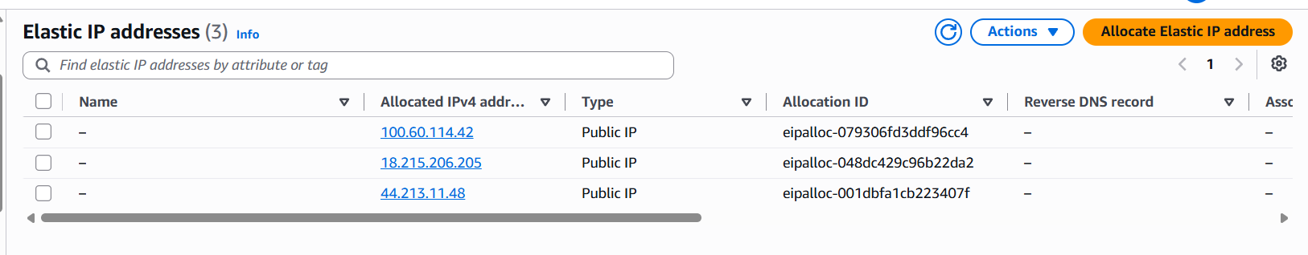
Key Features - Secure
NAT Gateway & Elastic IP

Slide 33
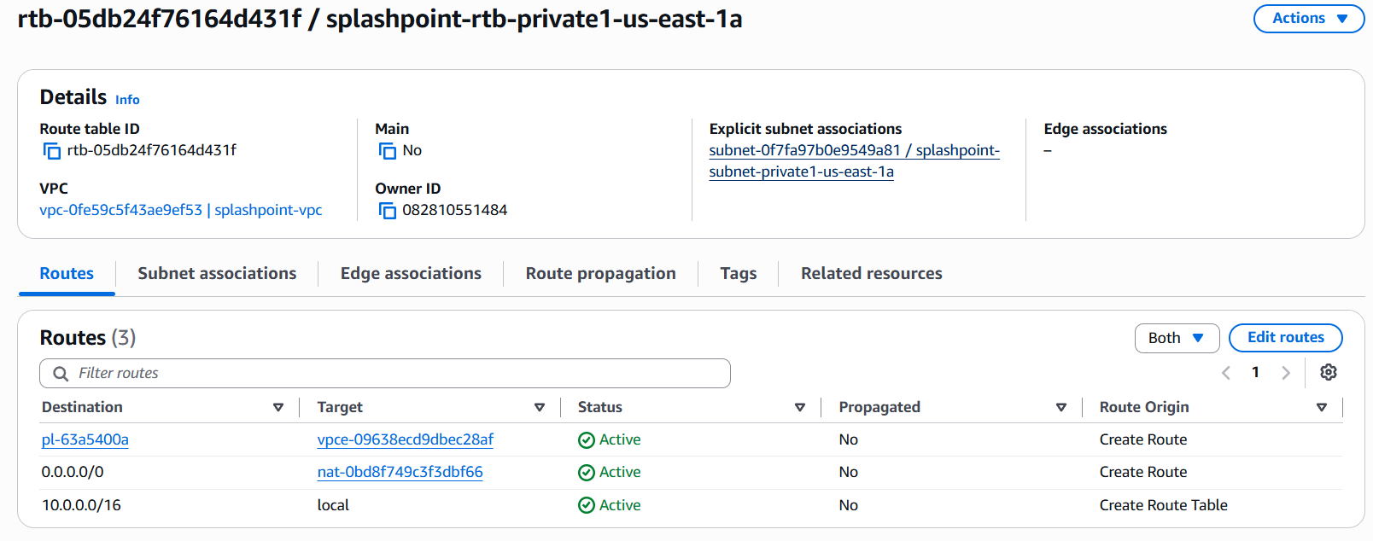
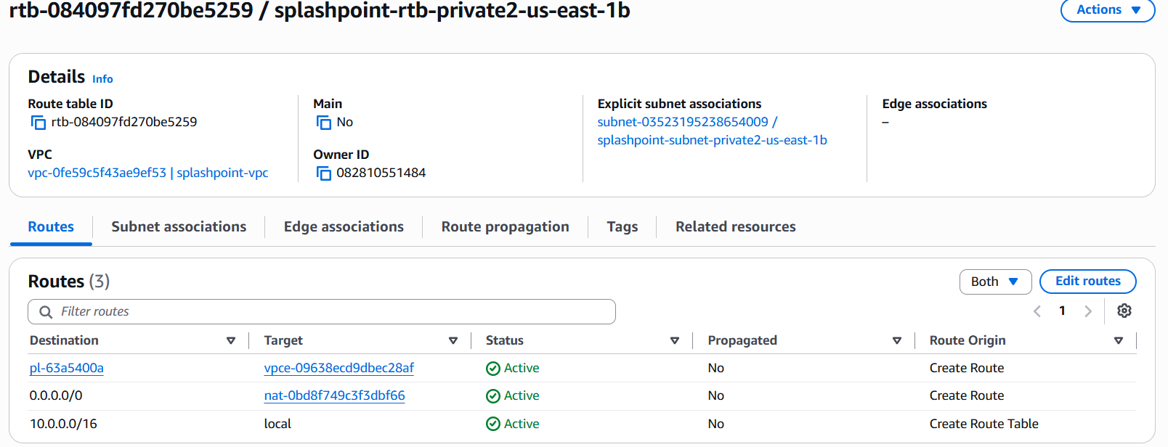
Key Features - Secure
Route Table

Slide 34
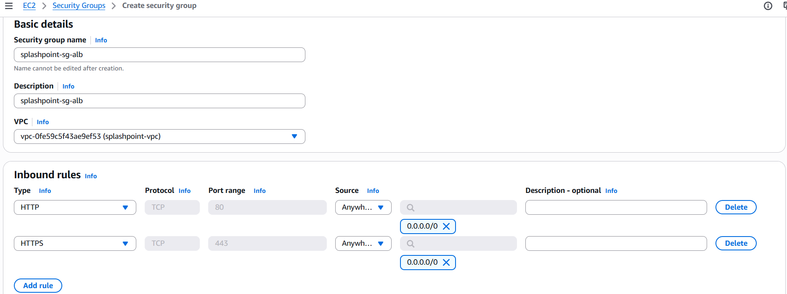
Key Features - Secure
Security Group - sg-alb

Slide 35
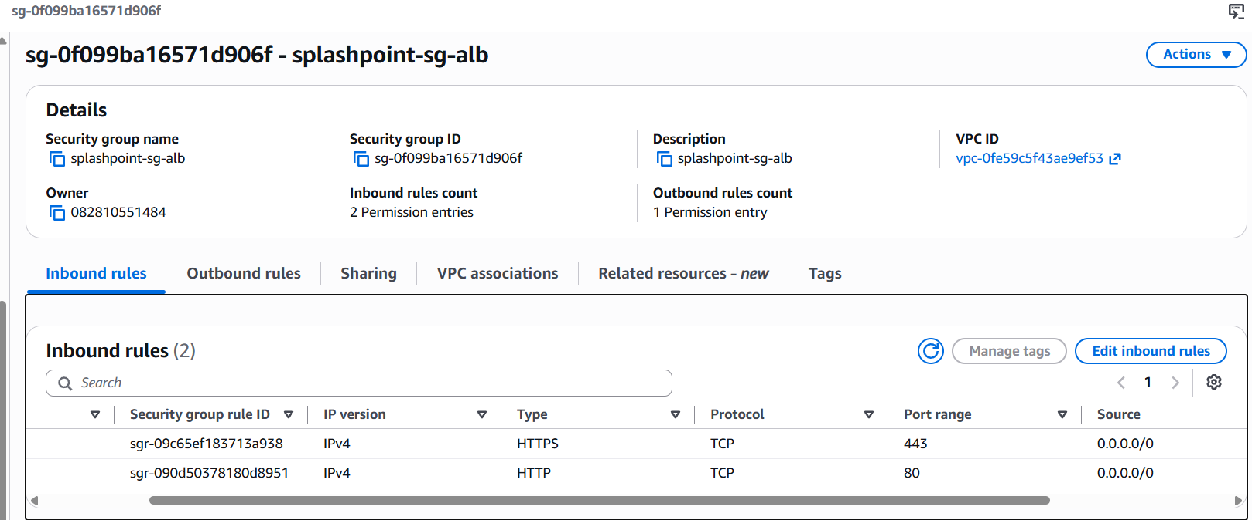
Key Features - Secure
Security Group - sg-alb

Slide 36
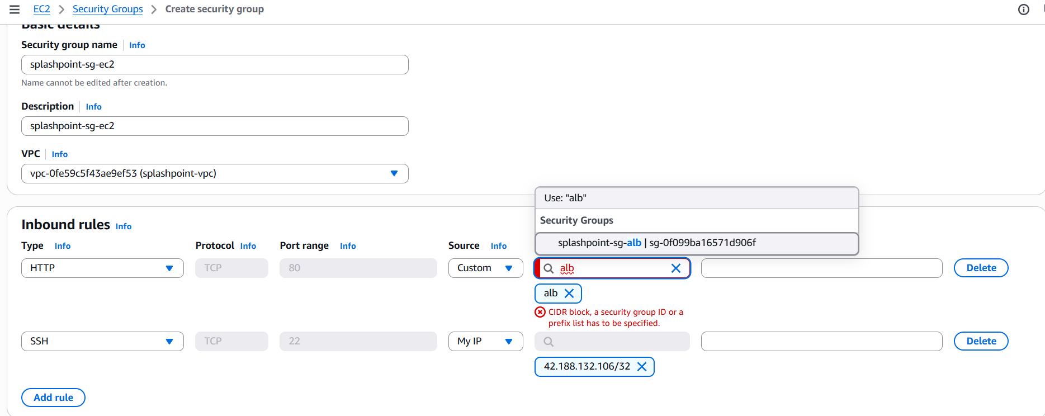
Key Features - Secure
Security Group - sg-ec2

Slide 37
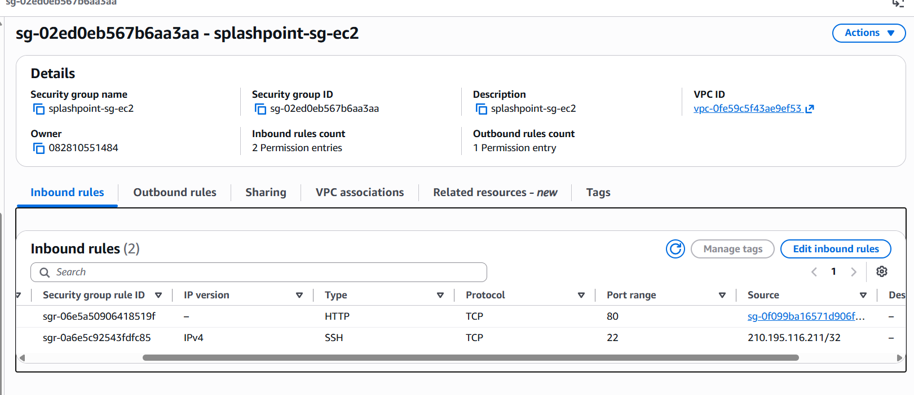
Key Features - Secure
Security Group - sg-ec2

Slide 38
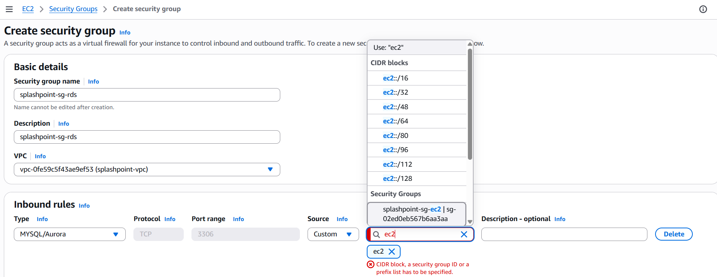
Key Features - Secure
Security Group - sg-rds

Slide 39
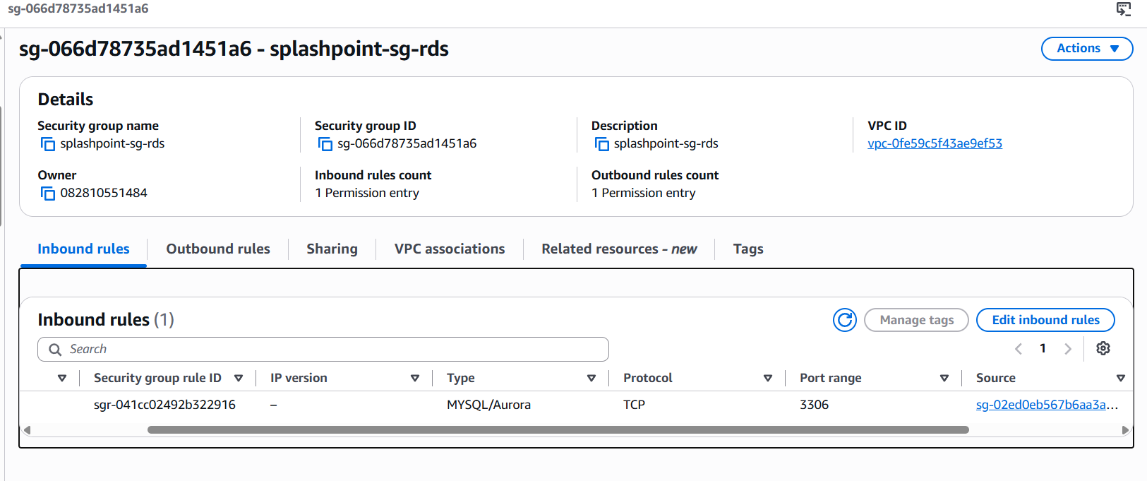
Key Features - Secure
Security Group - sg-rds

Slide 40
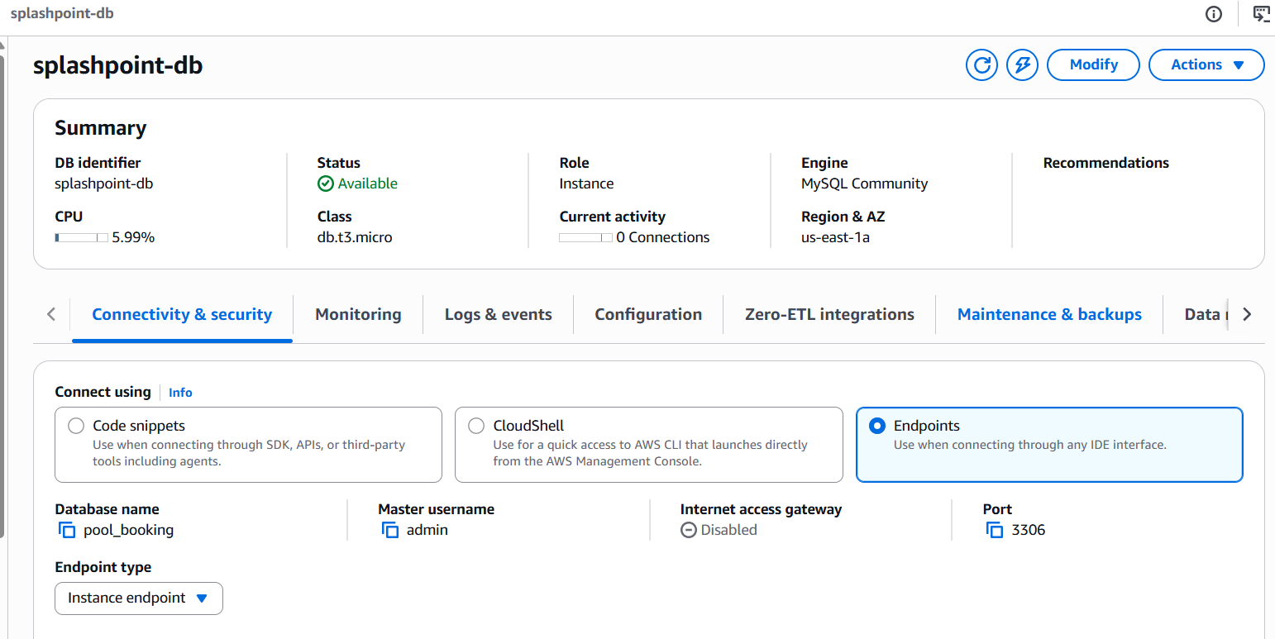
Key Features - Secure
RDS

Slide 41
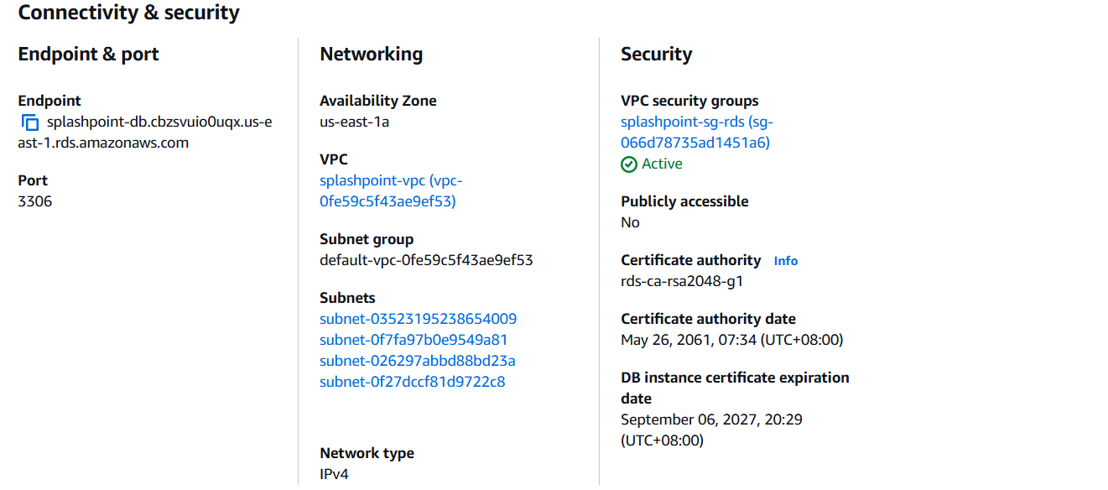
Key Features - Secure
RDS

Slide 42
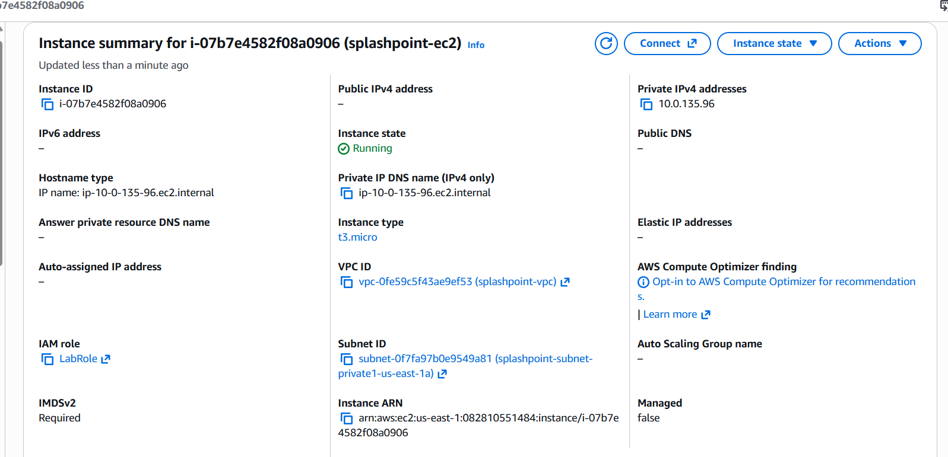
Key Features - Secure
Private EC2

Slide 43
Key Features - Secure
Our security design follows the "zero trust" principle—the EC2 application layer and the RDS database layer are completely isolated in a private subnet, with zero exposure to the external network. The only external entry point is ALB, with layers of restrictions from Security Group: ALB only accepts HTTP/HTTPS, EC2 only trusts traffic from ALB, and RDS only trusts traffic from EC2, forming a one-way trust chain.

Slide 44
Secure
Secure — Secrets Management & Edge Protection

Slide 45
Secure
Key Features - System Manager

Slide 46
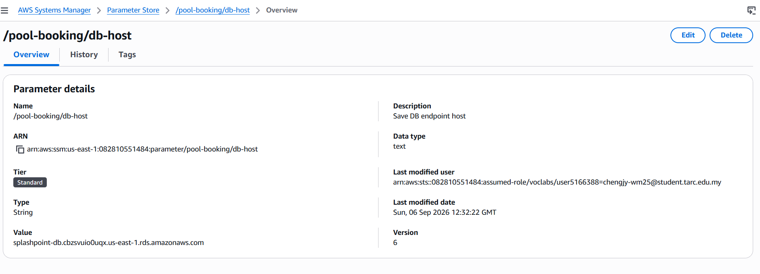
Key Features - Secure

Slide 47
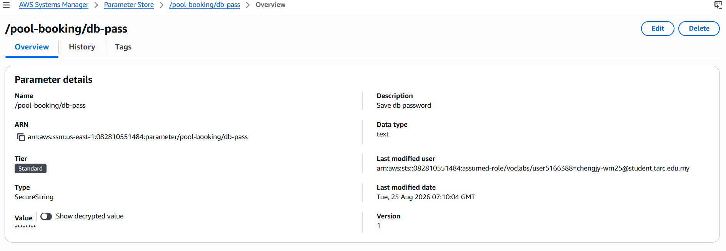

Key Features - Secure

Slide 48
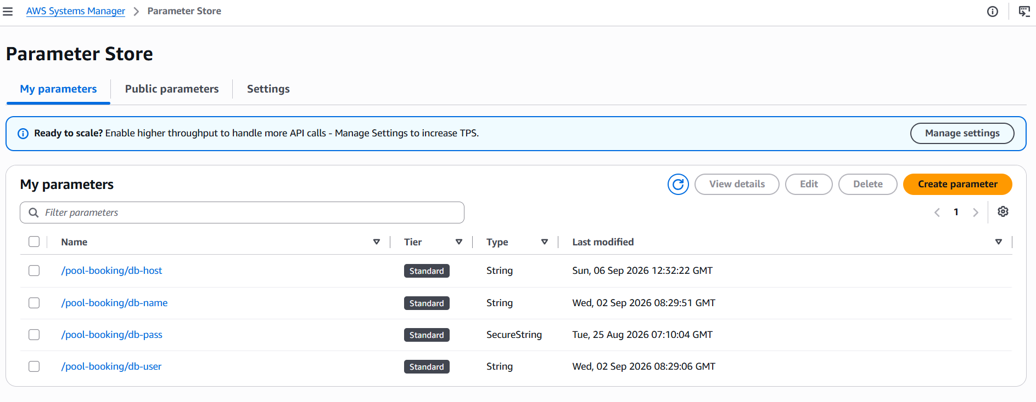
Key Features - Secure
DB_HOST=$(aws ssm get-parameter --name "/pool-booking/db-host" --region us-east-1 --query "Parameter.Value" --output text)
DB_USER=$(aws ssm get-parameter --name "/pool-booking/db-user" --region us-east-1 --query "Parameter.Value" --output text)
DB_PASS=$(aws ssm get-parameter --name "/pool-booking/db-pass" --with-decryption --region us-east-1 --query "Parameter.Value" --output text)
DB_NAME=$(aws ssm get-parameter --name "/pool-booking/db-name" --region us-east-1 --query "Parameter.Value" --output text)
sudo tee /etc/httpd/conf.d/db-env.conf << EOF
SetEnv DB_HOST $DB_HOST
SetEnv DB_USER $DB_USER
SetEnv DB_PASS $DB_PASS
SetEnv DB_NAME $DB_NAME
SetEnv IMAGE_BASE_URL https://jy-pool-booking-bucket.s3.us-east-1.amazonaws.com/
EOF

Slide 49
Secure
Key Features - WAF & Shield

Slide 50
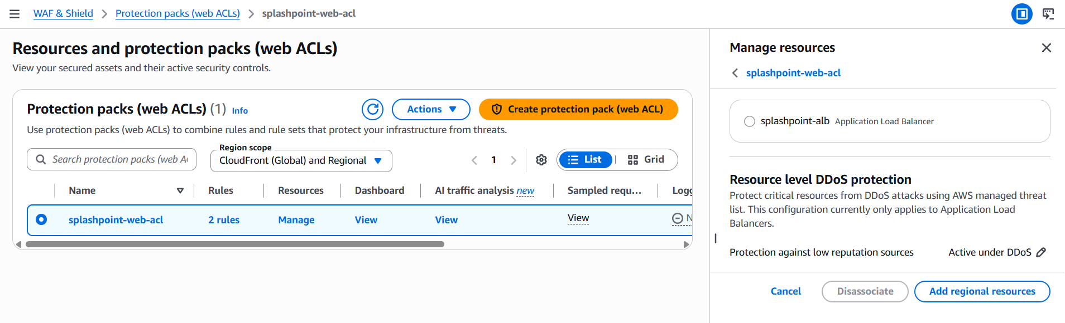
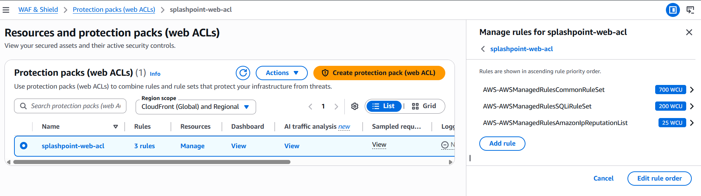
Key Features - Secure
WAF - Web Application Firewall

Slide 51
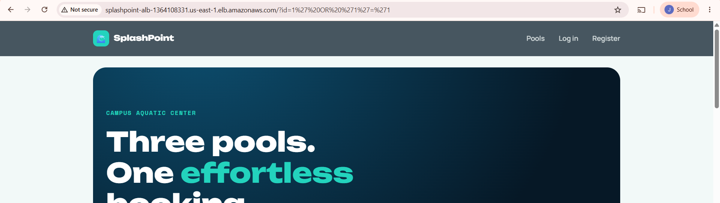
Key Features - Secure
When did not have setup WAF
Simulated attack test add - ?id=1' OR '1'='1

Slide 52
Key Features - Secure
In addition to network layer isolation, we also implemented application layer and edge layer protection. Database passwords are not hard-coded in configuration files, but are encrypted and stored using SecureString in the SSM Parameter Store, and EC2 dynamically retrieves them at boot time via IAM Role. Member passwords use bcrypt one-way hashes; the database does not store plaintext, so even if data is leaked, passwords cannot be reverse-engineered. An outermost layer of WAF is added to intercept common attacks such as SQL injection and XSS. We have actually tested attacks with malicious payloads; the system correctly returned a 403 error and recorded it.

Slide 53
Cost Optimized
Key Features

Slide 54
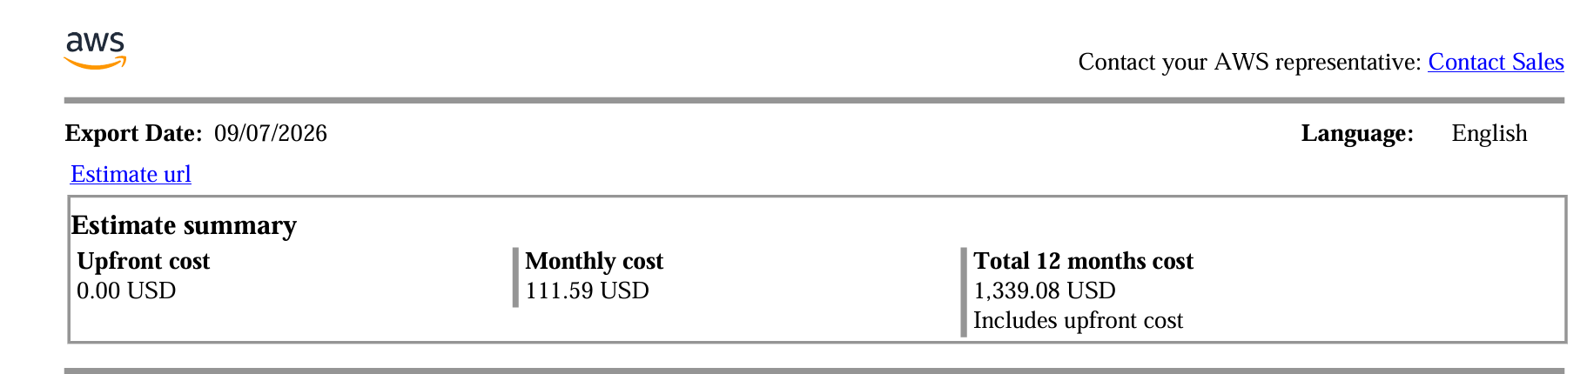
Key Features - Cost Optimized
Summary report link: https://calculator.aws/#/estimate?id=23588b3280df473ebb580ed19157a1e86458921e
Total Cost need ：111.59 USD per month

Slide 55
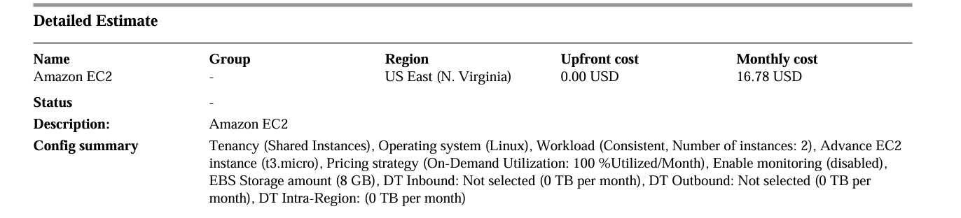
Key Features - Cost Optimized
This EC2 configuration is designed for a small application that needs to run continuously while keeping the overall cost low. Shared tenancy is selected because the physical server resources are shared with other AWS customers, making it a more affordable option. Linux is chosen because it is lightweight, widely supported, and suitable for many types of applications. Two t3.micro instances are used to provide basic reliability, so the application can continue operating if one instance experiences a problem. On-Demand pricing is suitable because the instances are expected to run continuously without requiring a long-term commitment. The 8 GB EBS storage provides basic space for the operating system and application files, while monitoring is disabled to avoid additional costs. The data transfer values are set to zero because the estimate assumes very little network traffic. Overall, this configuration provides a simple, affordable, and reliable solution for a small workload.

Slide 56
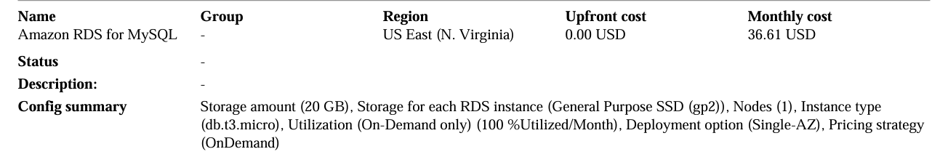
Key Features - Cost Optimized
This RDS for MySQL configuration is designed for a small database workload that needs to run continuously while keeping costs low. The 20 GB storage provides enough space for a small application database, while General Purpose SSD (gp2) offers a balance between storage performance and cost. One RDS node is selected because the workload is small and does not require a standby database. The db.t3.micro instance is a low-cost option suitable for applications with light database usage. 100% utilization per month means the database is expected to run continuously, 24 hours a day. The Single-AZ deployment is chosen because it is cheaper and suitable when high availability is not a major requirement. Finally, On-Demand pricing provides flexibility because there is no long-term commitment. Overall, this configuration provides a simple and affordable MySQL database solution for a small application.

Slide 57
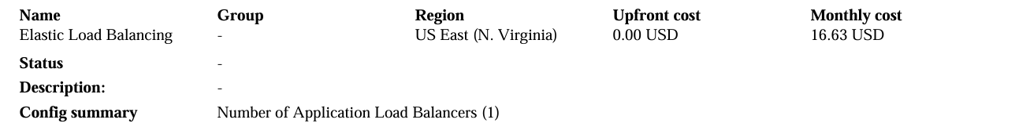
Key Features - Cost Optimized
The Elastic Load Balancing configuration with one Application Load Balancer (ALB) is suitable for distributing incoming application traffic across the two EC2 instances. The load balancer helps ensure that requests are directed to available servers, improving the application's reliability and availability. Using one ALB is sufficient for this small application setup and helps keep the overall AWS cost lower.

Slide 58
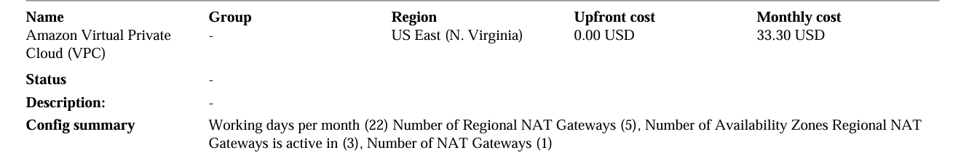
Key Features - Cost Optimized
This Amazon VPC configuration is designed to provide secure internet connectivity for the application while controlling costs. The 22 working days per month represents the estimated period of usage during a typical month. One NAT Gateway is used to allow resources in private subnets to access the internet securely without being directly exposed to incoming internet traffic. The NAT Gateway is active across 3 Availability Zones, providing better network availability. The configuration also includes 5 regional NAT Gateways, which represents the estimated regional usage for the cost calculation. Overall, this setup provides a balance between security, availability, and cost for the application.

Slide 59
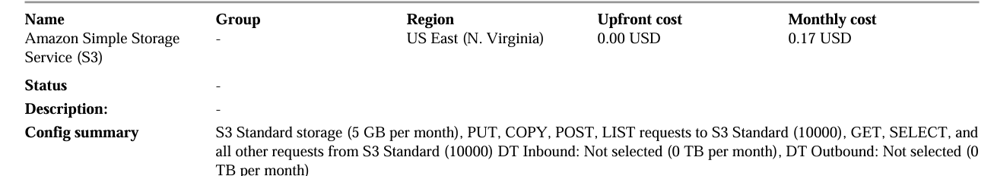
Key Features - Cost Optimized
This Amazon S3 configuration is designed for storing a small amount of application data at a low cost. The 5 GB of S3 Standard storage is suitable for storing files, images, documents, backups, or other application data that may need frequent access. The 10,000 PUT, COPY, POST, and LIST requests and 10,000 GET and other requests represent a small amount of activity between the application and S3. Data transfer is set to 0 TB because the estimate assumes there is no significant data transferred in or out of S3. Overall, this configuration provides simple, scalable, and affordable cloud storage for a small application.

Slide 60
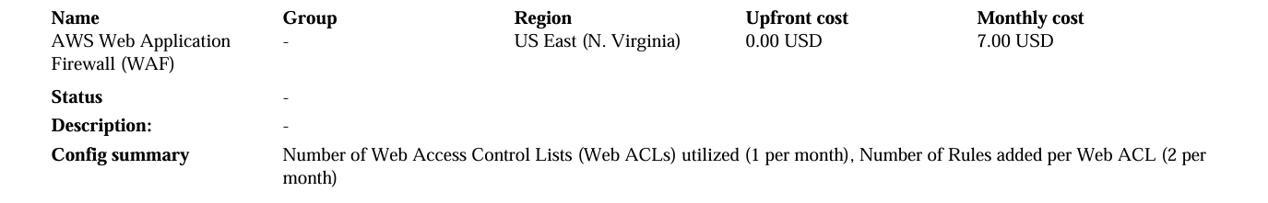
Key Features - Cost Optimized
The AWS Web Application Firewall (WAF) configuration is designed to protect the web application from common online threats. One Web ACL is used to control and filter incoming web traffic, while two rules are added to determine which requests should be allowed or blocked. This provides basic security for the application while keeping the configuration simple and cost-effective. Overall, AWS WAF helps protect the application from malicious or unwanted web traffic.

Slide 61
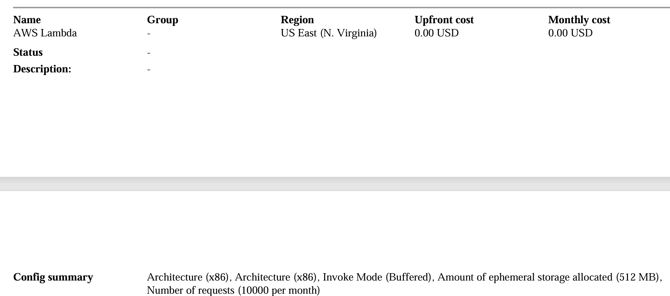
Key Features - Cost Optimized
This AWS Lambda configuration is designed for a small application that needs to run code without managing servers directly. The x86 architecture is chosen because it provides broad compatibility with common applications and libraries. The Buffered invoke mode allows Lambda to process requests asynchronously, which is suitable for tasks that do not require an immediate response. The 512 MB ephemeral storage provides temporary space for processing files and data during execution. With 10,000 requests per month, this configuration is suitable for a light workload while keeping costs low. Overall, AWS Lambda provides a flexible and cost-effective way to run application functions without maintaining additional servers.

Slide 62
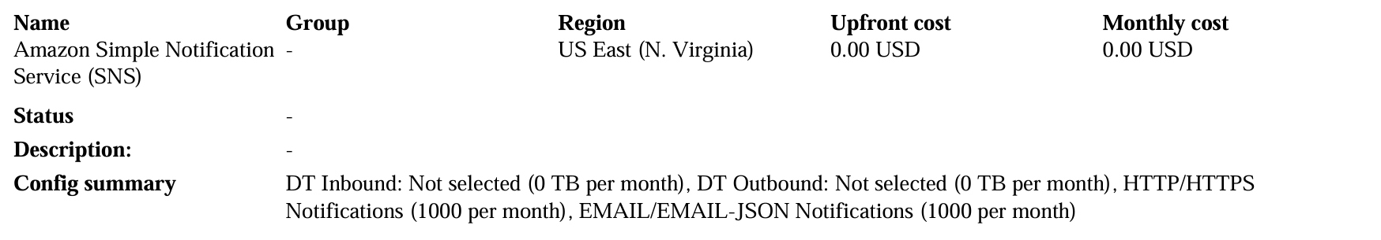
Key Features - Cost Optimized
The Amazon Simple Notification Service (SNS) configuration is used to send notifications and messages between different parts of the application. The HTTP/HTTPS notifications (1,000 per month) allow SNS to send messages to web applications or services, while EMAIL/EMAIL-JSON notifications (1,000 per month) allow notifications to be delivered through email. Data transfer is set to 0 TB because the estimate assumes there is no significant additional data transfer. Overall, SNS provides a simple and reliable way to send alerts, updates, and application notifications while keeping the setup cost low.

Slide 63
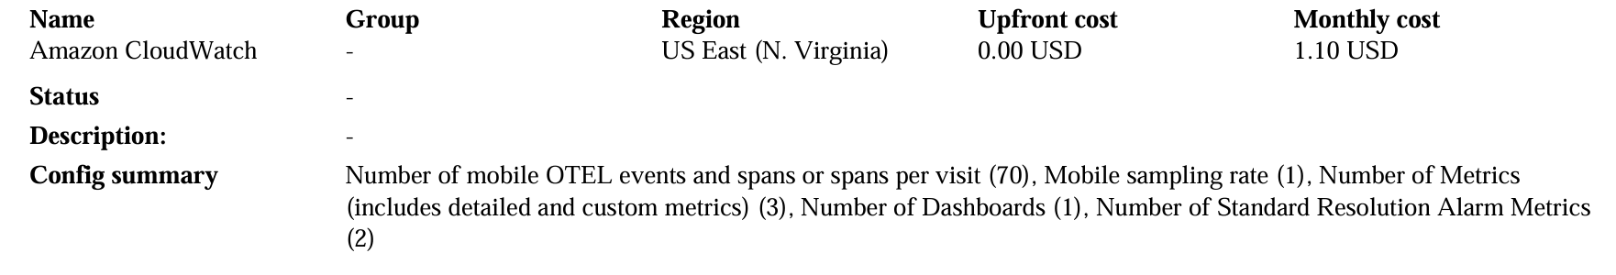
Key Features - Cost Optimized
The Amazon CloudWatch configuration is used to monitor the performance and health of the application. The 70 mobile OTEL events and spans are used to collect application activity and performance data, while a sampling rate of 1 means the monitoring collects all the specified events. Three metrics are used to track important application information, and one dashboard provides a central place to view the system's performance. Two standard-resolution alarm metrics are used to detect potential problems and generate alerts when certain conditions occur. Overall, this configuration provides basic monitoring and alerting to help maintain the application's performance and reliability.

Slide 64
Key Features - Cost Optimized
The following components and management services implemented in the architecture incur $0.00 base charge or fall entirely within the AWS Free Tier, and are categorized as Free / Negligible Cost in the estimate:
AWS Systems Manager (Parameter Store): Standard Parameters usage is free.
AWS CloudTrail: The first copy of Management Events (1st Trail) per region is free.
AWS Auto Scaling Group: The Auto Scaling service itself has no additional cost; charges apply only to the underlying EC2 instances it provisions.
Amazon VPC & Security Groups: Virtual Private Cloud infrastructure, subnets, routing tables, and Security Group network rules are provided free of charge.

Slide 65
High Performing
Key Features

Slide 66
High Performing
Key Features - CloudWatch Alarm

Slide 67
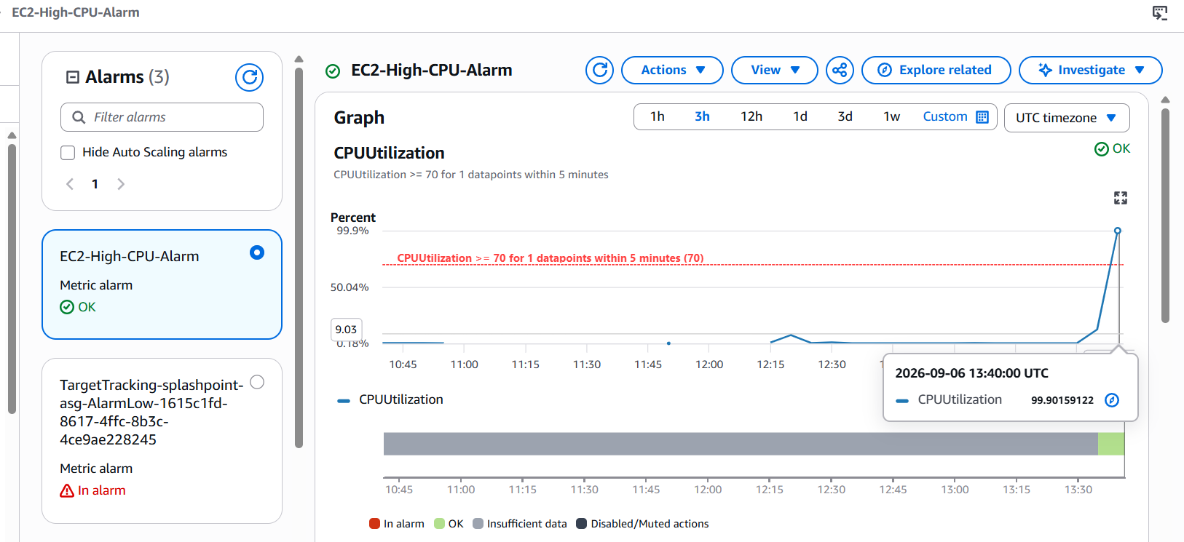
Key Features - High Performing
Test EC2-High-CPU-Alarm

Slide 68
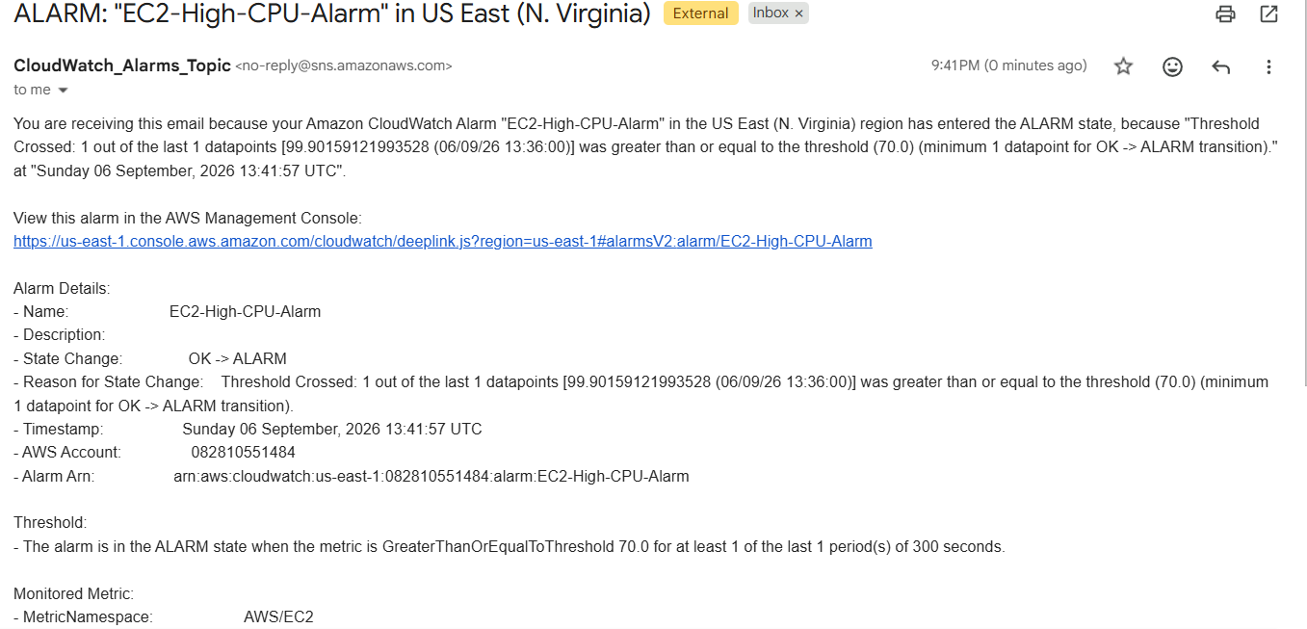
Key Features - High Performing
Email notification

Slide 69
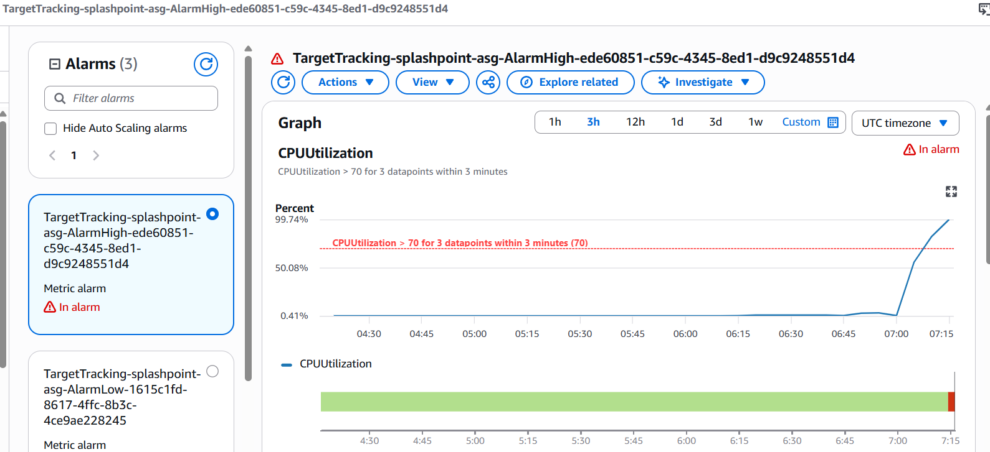
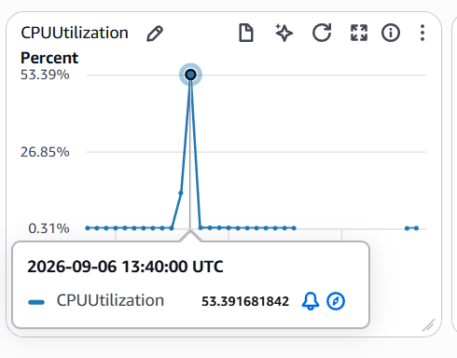
Key Features - High Performing
Asg - alarm

Slide 70
High Performing
Key Features - CloudWatch Dashboard

Slide 71
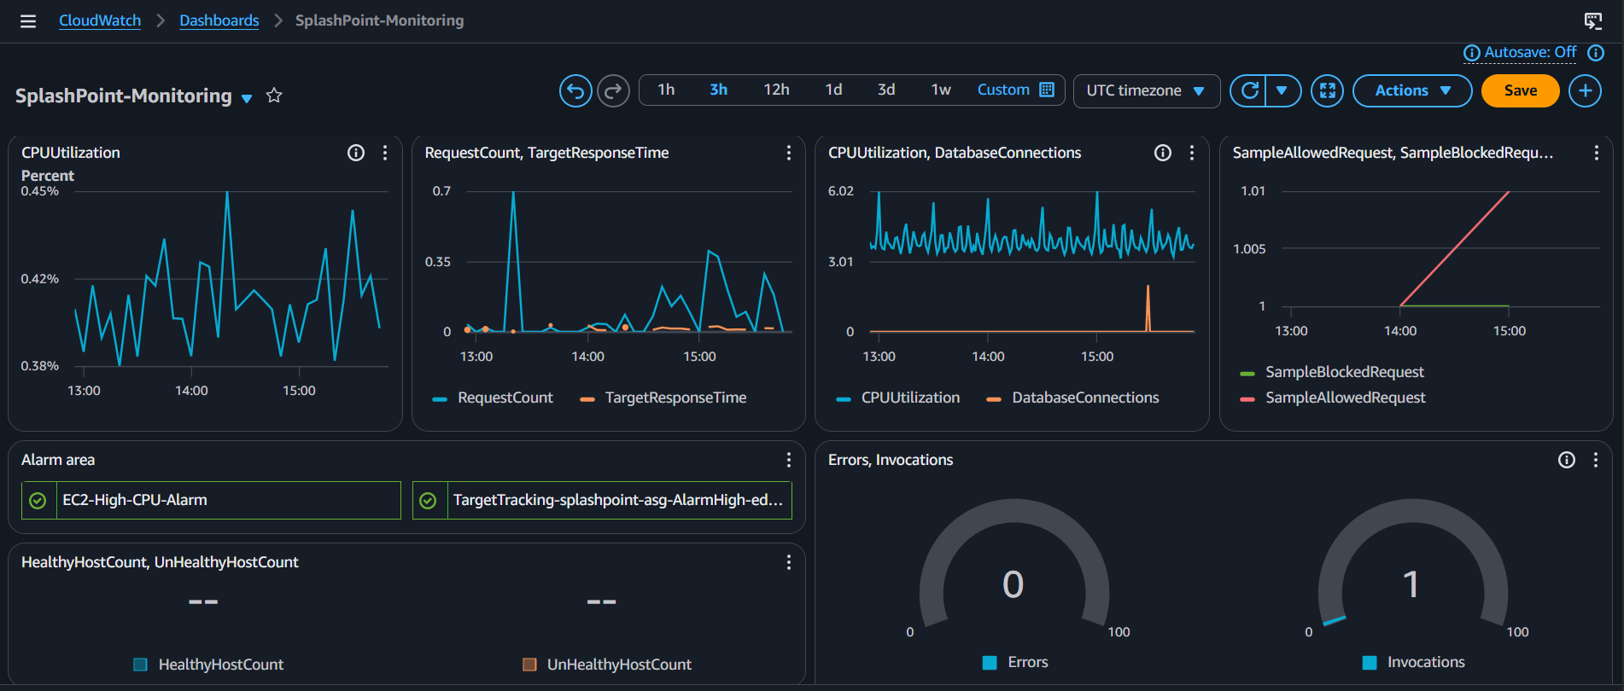
Key Features - High Performing
CloudWatch Dashboard + Alarm

Slide 72
High Performing
Key Features - Test Setup & Execution

Slide 73
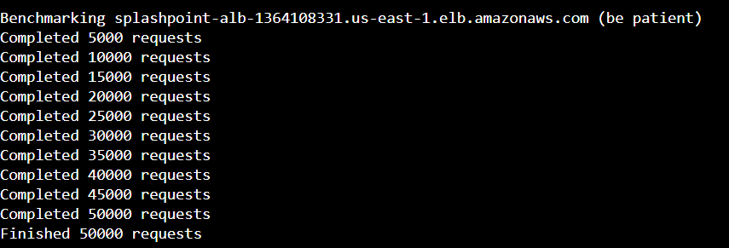
Key Features - High Performing
We used Apache Bench to simulate 50 concurrent users making a total of 50000 requests to the homepage. During the test, there were zero failed requests, and the average response time remained within an acceptable range. We also observed that when CPU utilization exceeded our set 70% threshold, the CloudWatch Alarm was triggered, and the Auto Scaling Group automatically increased from 1 instance to 2 instances. After the load was distributed, the system continued to operate stably, and when traffic decreased, it automatically shrunk back to its original capacity, proving that this architecture truly has the ability to dynamically scale up and down, and is not just a set-up system.
ab -n 50000 -c 50 http://splashpoint-alb-1364108331.us-east-1.elb.amazonaws.com/index.php

Slide 74
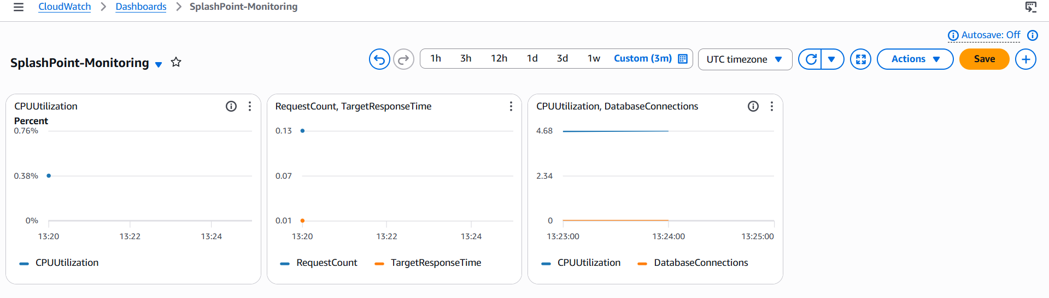
Key Features - High Performing
Before stress test

Slide 75
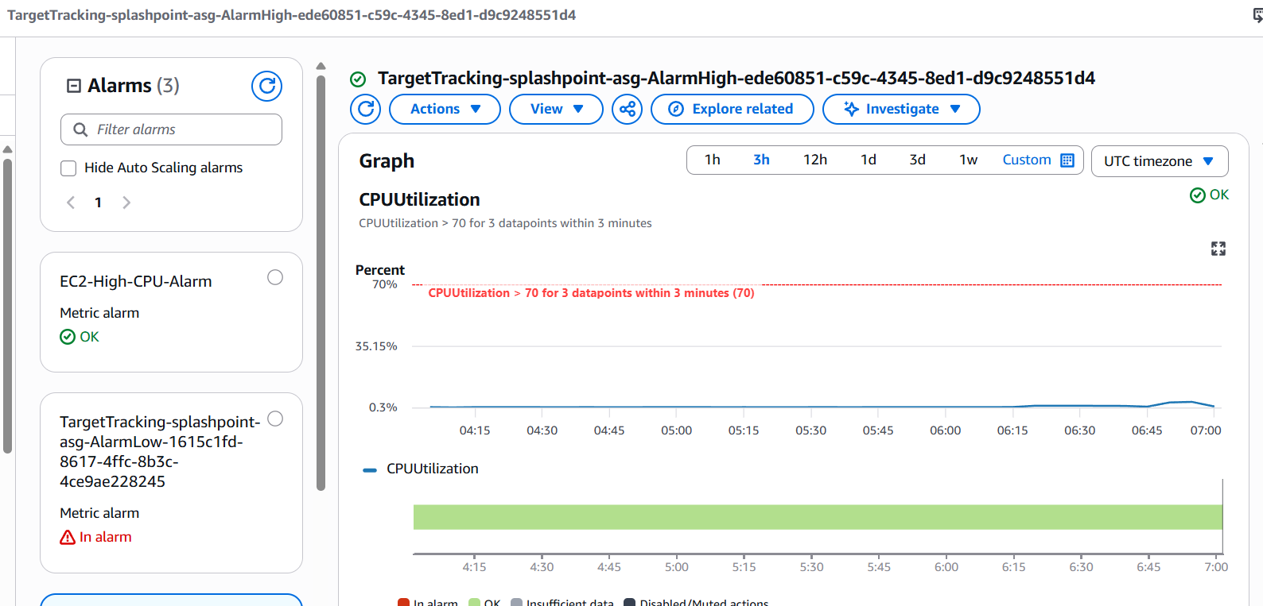
Key Features - High Performing

Slide 76

Key Features - High Performing

Slide 77
High Performing
Key Features - Scaling Under Load

Slide 78


Key Features - High Performing
After Stress Test

Slide 79
Key Features - High Performing

Slide 80

Key Features - High Performing

Slide 81


Key Features - High Performing

Slide 82

Key Features - High Performing

Slide 83
Scalability
Key Features

Slide 84
Scalability
Scalability — Configuration

Slide 85
Scalability
Key Features - Auto Scaling Group

Slide 86

Key Features - Scalability

Slide 87


Key Features - Scalability

Slide 88

Key Features - Scalability

Slide 89


Key Features - Scalability

Slide 90

Key Features - Scalability

Slide 91
Scalability
Scalability — Scale-Out & Scale-In in Action

Slide 92
Scalability
Scalability — Scale-Out in Action

Slide 93


Key Features - Scalability
Before stress test

Slide 94

Key Features - Scalability

Slide 95
Key Features - Scalability

Slide 96
Key Features - Scalability
After stress test

Slide 97
Key Features - Scalability

Slide 98

Key Features - Scalability
After stress test

Slide 99
Scalability
Scalability — Scale-In in Action

Slide 100

Key Features - Scalability
Scale-In

Slide 101


Key Features - Scalability

Slide 102


Key Features - Scalability

Slide 103
Key Features - Scalability
We use a Target Tracking scaling policy, with the overall average CPU utilization of ASG as the metric, and a threshold set at 70%. When the average load exceeds this threshold, AWS will automatically calculate how many instances need to be added to bring the CPU back to near the target value, without requiring us to manually intervene to determine how many to add.

Slide 104
Load Balanced
Key Features

Slide 105
Load Balanced
Load Balanced — Configuration

Slide 106
Load Balanced
Key Features - Application Load Balanced

Slide 107
Key Features - Load Balanced
VPC

Slide 108
Key Features - Load Balanced
2 AZ - 2 Public & 2 Private Subnet

Slide 109

Key Features - Load Balanced

Slide 110
Key Features - Load Balanced

Slide 111
Key Features - Load Balanced
Our ALB spans two Availability Zones, and instances under the Target Group are also distributed across these two Availability Zones. This design aims to ensure that even if one Availability Zone experiences a problem, instances in the other Availability Zone can continue to provide service, preventing a single point of failure.

Slide 112
Load Balanced
Load Balanced — Even Traffic Distribution

Slide 113


Key Features - Load Balanced
Using : sudo wc -l /var/log/httpd/access_log
Before sending request

Slide 114


Key Features - Load Balanced
After sending request using :
ab -n 5000 -c 200 http://splashpoint-alb-1364108331.us-east-1.elb.amazonaws.com/index.php
55903 - 53395 = 2508
3866 - 1438 = 2428
two instances differed by at least less than [5%]

Slide 115
Key Features - Load Balanced
By comparing the number of access log requests for each instance, we verified that the ALB traffic distribution was indeed even – the number of requests handled by the two instances differed by less than [5%], proving that no single instance was overloaded with requests and that the load was indeed evenly distributed, rather than being carried by a single instance.

Slide 116
Additional Services

Slide 117
Additional Services - Lambda + SNS

Slide 118

Key Features - Load Balanced
SNS Topic

Slide 119


Key Features - Load Balanced
Create lambda & it function

Slide 120

Key Features - Load Balanced
Create Subscriptions

Slide 121

Key Features - Load Balanced
Add SNS trigger

Slide 122

Key Features - Load Balanced
Inside the code use back the SNS arn link to connect

Slide 123


Key Features - Load Balanced

Slide 124

Key Features - Load Balanced

Slide 125


Key Features - Load Balanced

Slide 126
Additional Services - S3

Slide 127

Key Features - Load Balanced
S3 bucket

Slide 128


Key Features - Load Balanced

Slide 129

Key Features - Load Balanced
Using SetEnv to connect s3 bucket
sudo tee /etc/httpd/conf.d/db-env.conf << EOF
SetEnv DB_HOST $DB_HOST
SetEnv DB_USER $DB_USER
SetEnv DB_PASS $DB_PASS
SetEnv DB_NAME $DB_NAME
SetEnv IMAGE_BASE_URL https://jy-pool-booking-bucket.s3.us-east-1.amazonaws.com/
EOF

Slide 130

Key Features - Load Balanced

Slide 131

Key Features - Load Balanced

Slide 132

Key Features - Load Balanced

Slide 133
Additional Services - Cloud Trail

Slide 134


Key Features - Load Balanced

Slide 135


Key Features - Load Balanced

Slide 136
Conclusion

Slide 137
Conclusion
Challenges & solutions
Learner Lab IAM restrictions blocked certain services (CloudFront, SES) — tested cheaply first, pivoted to alternatives (Gmail SMTP)
PHP sessions broke across multiple EC2 instances behind the ALB — solved with a database-backed session handler
New ASG instances launched with outdated configuration — solved by moving setup logic into Launch Template User Data
AWS resources used
AWS Systems Manager (Parameter Store) documentation
AWS WAF Managed Rule Groups
AWS Pricing Calculator
AWS Academy Learner Lab service-restriction notes
Notes:
Describe any challenges that you encountered and how you overcame those challenges.
For example: “I got stuck when I was creating an EC2 instance to host the application. I used the resources that were listed in the instructions to walk myself through the process to create a new EC2, and I was able to complete the task. The links to labs in other courses were very helpful.”
Describe any new skills that you learned from this project.
For example: “I learned how to set up auto scaling correctly so my resources were automatically adjusted and allocated at the lowest possible cost.”
Discuss any future, out-of-scope use cases in the next steps.
For example: “I would like to scale out the web application so that multiple departments can use it.”

Slide 138
Conclusion
New skills gained
Auto Scaling Group configuration with Launch Templates & User Data bootstrapping
IAM least-privilege Security Group design
Serverless event-driven architecture (SNS + Lambda)
Load testing methodology (Apache Bench)
Future plan
Migrate to HTTPS with a custom domain + ACM certificate
Automate deployment via S3 + Instance Refresh (CI/CD-style)
Move email confirmation to Amazon SES once verified for production
Explore VPC Endpoints to remove NAT Gateway dependency
Notes:
Describe any challenges that you encountered and how you overcame those challenges.
For example: “I got stuck when I was creating an EC2 instance to host the application. I used the resources that were listed in the instructions to walk myself through the process to create a new EC2, and I was able to complete the task. The links to labs in other courses were very helpful.”
Describe any new skills that you learned from this project.
For example: “I learned how to set up auto scaling correctly so my resources were automatically adjusted and allocated at the lowest possible cost.”
Discuss any future, out-of-scope use cases in the next steps.
For example: “I would like to scale out the web application so that multiple departments can use it.”

Slide 139
References

Slide 140
References - Official Cloud & Service Documentation

Slide 141
References
AWS Official Documentation:
  Amazon Web Services. (2024). Amazon Elastic Compute Cloud (EC2) User Guide. AWS Documentation. https://docs.aws.amazon.com/ec2/
  Amazon Web Services. (2024). Application Load Balancer Documentation. AWS Documentation. https://docs.aws.amazon.com/alb/
  Amazon Web Services. (2024). Amazon Aurora & RDS User Guide. AWS Documentation. https://docs.aws.amazon.com/rds/
  Amazon Web Services. (2024). Auto Scaling Groups User Guide. AWS Documentation. https://docs.aws.amazon.com/autoscaling/
  Amazon Web Services. (2024). AWS Systems Manager Parameter Store User Guide. AWS Documentation. https://docs.aws.amazon.com/systems-manager/latest/userguide/systems-manager-parameter-store.html
  Amazon Web Services. (2024). AWS WAF, AWS Shield, and AWS Firewall Manager Developer Guide. AWS Documentation. https://docs.aws.amazon.com/waf/

Slide 142
References - Tools, Web Technologies & Open Source Libraries

Slide 143
References
Performance Testing & Benchmarking:
Apache Software Foundation. (2024). ab - Apache HTTP server benchmarking tool. Apache HTTP Server Documentation. https://httpd.apache.org/docs/2.4/programs/ab.html
Core Application Stack & Languages:
PHP Documentation Group. (2024). PHP: Hypertext Preprocessor Documentation. PHP.net. https://www.php.net/docs.php
The MySQL Team. (2024). MySQL 8.0 Reference Manual. Oracle Corporation. https://dev.mysql.com/doc/refman/8.0/en/
AWS Pricing & Estimation Tools:
Amazon Web Services. (2024). AWS Pricing Calculator. https://calculator.aws/

Slide 144
Appendix (If any) - None

Slide 145
Thank you

